Slide 1
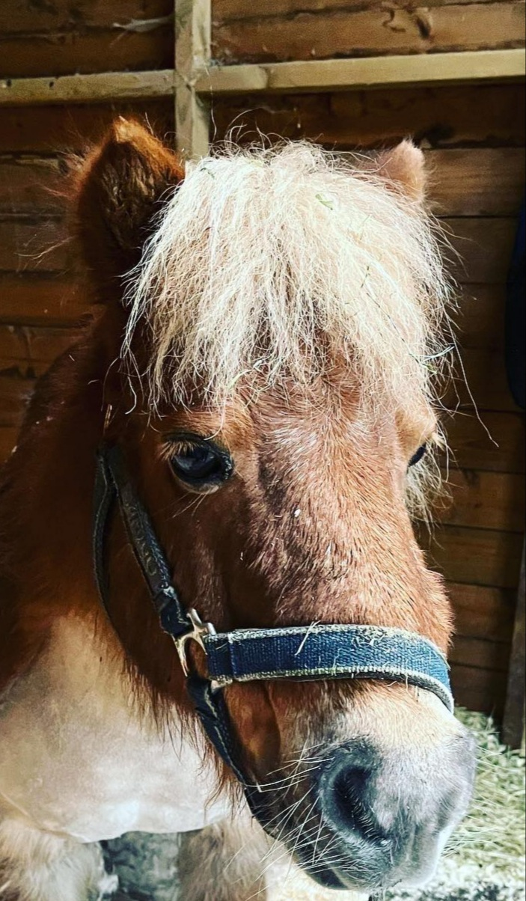
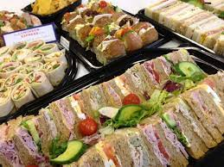
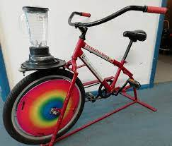
There will be a series of short talks on ways to keep healthy
Time | Topic | Speaker
10am | Healthy eating tips to keep well and prevent/manage diabetes | Julie Knitter Diabetes Dietician
11am | The learning disability care co-ordinators role and importance of the annual health checks | Karen Crawford and Naomi Perkins LD Care Co-ordinators at GPs
12pm | Red flag symptoms for cancer and keeping yourself safe | Hayley Taylor- Cox Lead for Cancer Prevention Public Health
1pm | The importance of good oral hygiene and what reasonable adjustments are available | Anne Jepson Senior Oral Health Promoter from Kingsgate Dentist
2pm | The importance of getting your eyes tested and what reasonable adjustments are available | Rebecca Lunness Joanne Kennedy from SeeAbility
3pm | Pure Innovations' new Talking Therapies service | Paige Artus and Ruth Whitehouse Talking Therapies
BIG HEALTH DAY
For adults with learning disabilities and their carers
Learn about what you can do to look after your body, stay healthy and live a long life.
Thursday 22nd June
10am-4pm
At Vernon Park Café, Turncroft Lane, Stockport SK1 4AR
Fudge the pony Free lunch Smoothie bike

