Slide 1
Help with cost of living increase
By Saima Shezadi & Peter Douglas

Slide 2
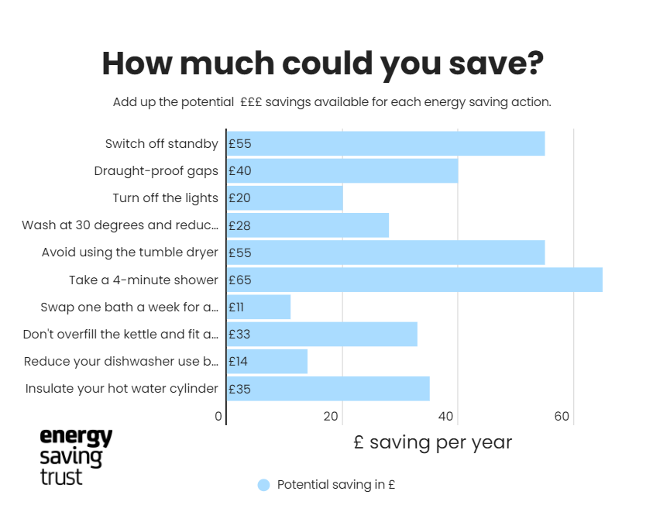
How much could we save?
We’re all responsible for the energy we use in our homes. Take a look at our quick tips and see how you could save up to £356 a year* on your bills.
Whether you’re a homeowner, a private or social renter, a student, or you live with your parents, there are many things you can do.
Further information and tips available on the Energy saving Trust website .

Slide 3
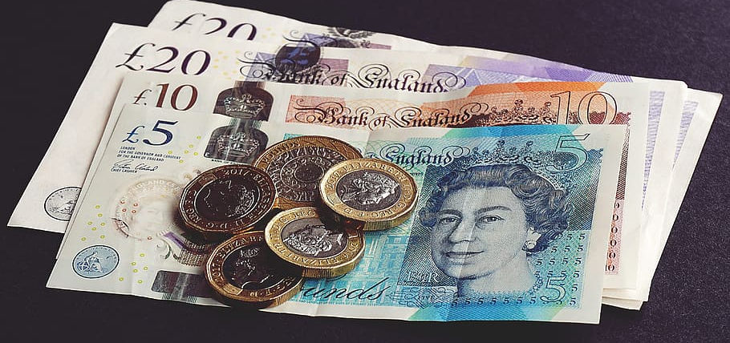
Cost of living rises
Increase in energy bills and fuel costs Some of the factors driving the current spike in prices include:
High demand for oil and gas has led to higher costs for energy companies and subsequently, their customers.
Government support offered during the pandemic, such as reduced VAT rates in hospitality, ending.
Shortages in staff across a number of sectors including hospitality and transport. This is partly due to the pandemic and also compounded by Brexit.
Shortages of some goods due to supply chain disruptions.
Inflation has already risen past 5 percent, and the Bank of England has estimated that this rate will increase beyond 7 percent by spring, meaning further price hikes are on the way.

Slide 4
Energy bills
The energy crisis has been ongoing for several months due to a global increase in demand for oil and gas pushing up prices. The crisis has worsened since Russia’s invasion of Ukraine. This has pushed up prices even further, with petrol hitting a record price of £1.55 per litre in early March.
Because the wholesale price of gas has increased, the purchase price for energy providers has increased, meaning costs are passed along to consumers – i.e. ordinary households. Prices have already been creeping up in the last few months, but bills are set to skyrocket in April when the energy price cap is lifted.
The price cap limits how much energy companies are allowed to charge consumers for the energy they use. Once this is lifted in April, those who are on default tariffs and prepayment metres will be affected, with the price cap rising by 54 per cent. Those who are on default tariffs will see an increase of £693 from £1,277 to £1,971 per year, while prepayment customers will see an increase of £708 from £1,309 to £2,017. Normally, customers facing increases in energy costs would be able to shop around for better deals, but options are now limited due to the fact that all suppliers are facing higher purchase costs.
Financial journalist Martin Lewis has suggested that customers using a prepayment meter check whether they are able to build a stockpile of energy by purchasing as much as they can afford before April when prices rise. If on a direct debit, he suggested that taking a meter reading immediately and again on March 31 could ensure as much energy as possible is charged at the lower rate.

Slide 5
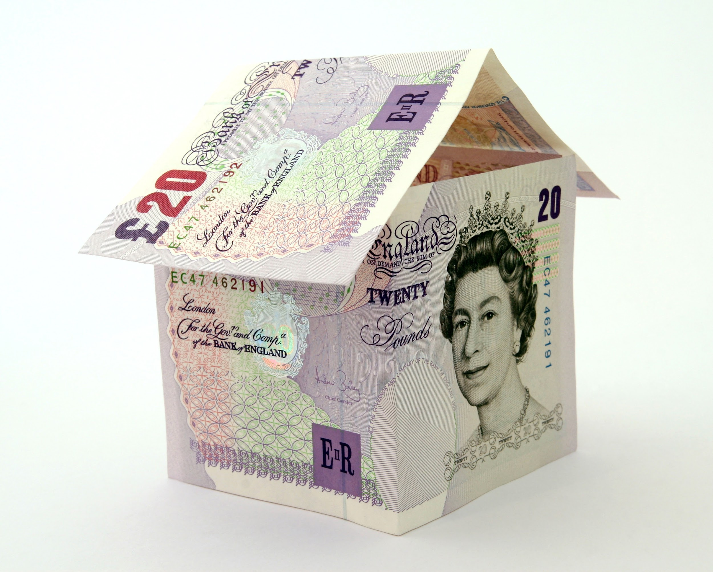
Rent, bills and mortgages
The cost of private renting is rising at its fastest rate in the past five years, rising by 2 per cent in 2021, according to data from the Office for National Statistics.
Households in council tax bands A to D will be eligible for a council tax rebate of £150 from April.
Home owners will likely be hit by an increase in costs from April, with those paying a standard variable rate on their mortgage seeing an increase in payments by an average of £15 per month. This is because of the Bank of England’s decision to raise the base rate in December 2021.
A number of broadband and mobile providers will also be increasing their charges from April, with BT adding £42 per year onto bills for customers. It would be advisable to shop around for cheaper deals if you know your prices will increase.

Slide 6
Groceries
According to market analysts Kantar, grocery prices rose at their fastest pace in more than eight years during February, hitting 4.3 percent increase.
This represents the steepest rise since September 2013, with the price of fresh beef, cat food and savoury snacks rising the fastest.
With inflation set to rise again in April, and the conflict in Ukraine creating disruption to supply chains, prices are expected to continue rising.

Slide 7
Taxes
From April 6 2022 to April 5 2023 national insurance contributions will increase by 1.25 percent in order to tackle massive backlogs in the NHS and the underfunding of the social care sector.
The hike will leave somebody on a salary of £30,000 paying around £251 more in contributions over the year.
The proposals have been controversial because those over state pension age that are likely to benefit most in the short-term, do not have to pay it.
Instead, young people will shoulder the burden of the hike disproportionately, with any graduates earning more than £27,295 paying a marginal tax rate of 42.25 percent after student loans, income tax and national insurance contributions are deducted from their salary.
There have been calls from multiple sectors to freeze the hike in order to tackle the cost of living crisis, but the government has not indicated that the rise will be halted or withdrawn.

Slide 8
Travel
At the start of March, rail fares rose by 3.8 percent.
In spite of calls to scrap it, the government defended its decision to go ahead with the rise, saying the hike taking place in March gave commuters ample opportunity to purchase season tickets at old prices.
Labour have criticised the decision, however, saying that commuters will see average fares rise to 48.9% more than they were in 2010.

Slide 9
So how much worse off will I actually be?
Although minimum wage, benefit payments and pension payments will all increase in April, these rises will not match the spiralling costs faced by households across the UK.
This means that, in the absence of wage increases, most households will be worse off in 2022.
The Resolution Foundation has estimated that typical household income will fall by £1,000 once the impacts of inflation have been accounted for.
The additional costs will affect poorer households disproportionately due to the fact that they pay a higher percentage of their income on things like energy bills.

Slide 10
What is the government doing to tackle the problem?
Chancellor Rishi Sunak announced that the government will be providing an energy bill rebate to 28 million households to ease the pressure of rising costs.
The upfront discount of £200 on bills, which was applied in instalments of £40 from October 2021.
Households in England in council tax bands A-D will also receive a £150 rebate on council tax bills in a one-off payment in April. On top of this discount, the government says it will provide discretionary funding of £144 to support vulnerable people and individuals on low incomes that do not pay Council Tax, or that pay Council Tax for properties in Bands E-H.
In January the government announced it would be freezing the cost of the BBC licence fee as part of measures to tackle the cost of living crisis.

Slide 11
Where can I get help if I’m struggling?
If you’re struggling with increased costs, there are many different ways you can seek help.
On energy bills, the government has a host of existing schemes you may be eligible for, such as the Warm Home Discount and Winter Fuel Payment.
The government is also offering £200 loans for energy bills in October which will be paid back on subsequent bills.
Citizens advice has a comprehensive list of grants and schemes for paying your energy bills on its website.
Water suppliers have schemes available to help customers pay their bills
For rent, you may be able to get help through claiming universal credit, which has now replaced housing benefit.

Slide 12
If you already claim benefits, and they don’t cover your housing costs, you may be able to get a discretionary housing payment through your local authority to help cover the shortfall. Council tax support/reduction is also available via your local authority if you’re struggling to pay. If you pay your bill by direct debit and are in council tax bands A-D, you should get an automatic rebate in April. Your local council may also be able to help you if you’re struggling to buy essentials like food – and you don’t necessarily need to be in receipt of benefits to get help. Alternatively, you could seek help from a food bank if you’re having a hard time paying for meals. The Trussell Trust – the largest UK food bank organisation – has a list of food banks you can access on its website. Citizens Advice has a comprehensive guide on what to do if you’re struggling with living costs of all kinds, and can be contacted to help signpost you to services which can help.

