Slide 1
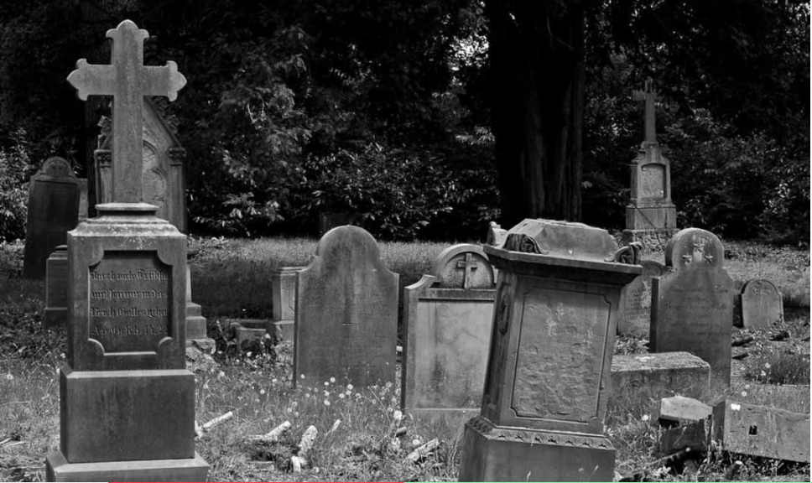


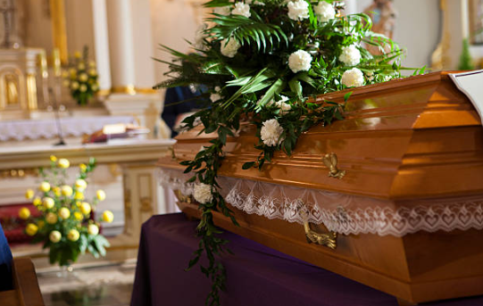
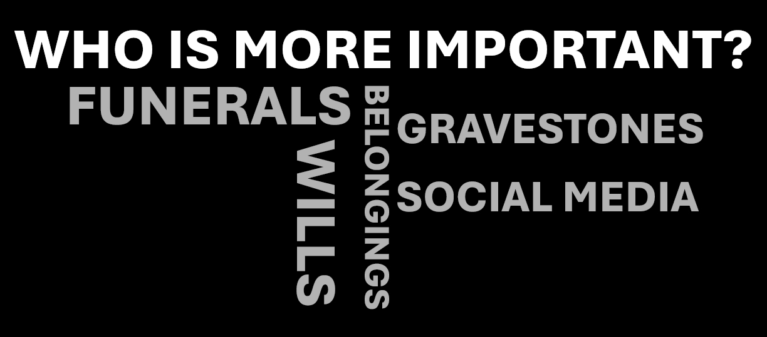
PARTICIPANTS WANTED FOR RESEARCH
INTERVIEWS
Understanding Hierarchy in Bereavement Contexts
Hierarchy:
The subjective ranking of people as ‘more’ or ‘less’ important after a person has died.
Participants must:
Be 18+
Have experienced a bereavement in the UK in the past 10 years.
Have experienced hierarchy at least once in a bereavement and grief context.
For more information/to take part contact Jennie on j.dayes@mmu.ac.uk.
Hierarchy flyer. V1.0. EthOS ID: 23837. 31st October 2025.

