Slide 1
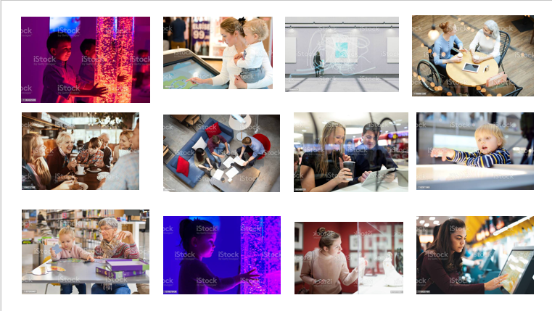
Stockroom Engagement
Stockport has successfully bid for £14.5m of Government Future High Street Fund money to transform vacant retail units in the heart of our high street, Merseyway. The Future High Street Fund bid was for Stockroom. Stockroom - a 21st century, universal learning and discovery space which could give the people of Stockport an opportunity to learn new skills, practice arts and crafts, enjoy live music and performances, use free services, and benefit from cutting-edge learning and IT facilities.
We’ve secured the funding…….Now we need your help to create something special!
Complete the survey and have your say
https://stockroomstockport.uk.engagementhq.com/stockroom

Slide 2
Where would Stockroom be located?
Stockport. Change here.
Stockport. Change here.
Peak District (20km)
Stockport Exchange
Stockport Rail Station
Covent Garden Village
Civic
Quarter
Town Centre West MDC
Hat Works
Stockport Interchange
Merseyway Shopping Centre
Paza
A6
Stockroom
Market Place & Underbanks
Redrock Stockport
Manchester (11km)
M60 Motorway
River Mersey

Slide 3
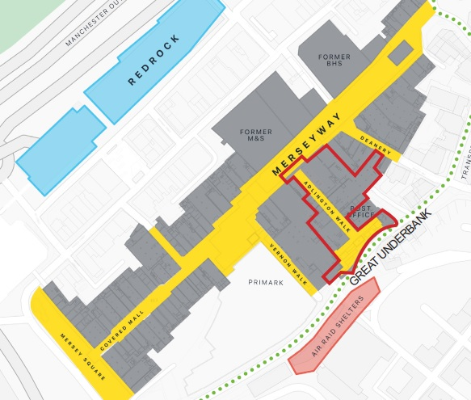
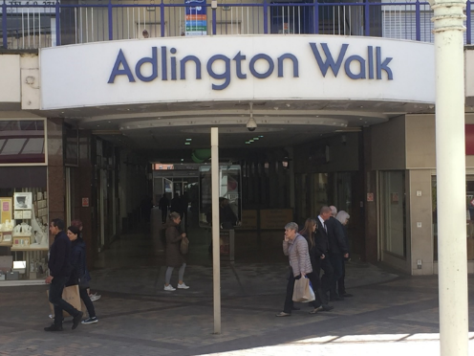
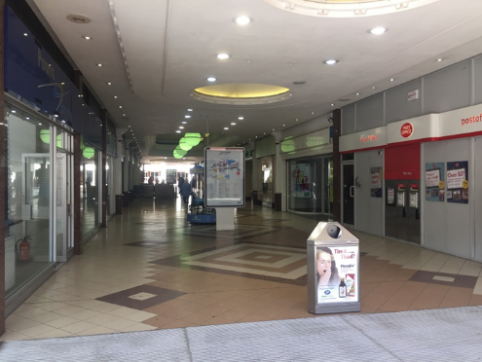
In the heart of Merseyway on Adlington Walk.
Stockroom
One Stockport Hub

Slide 4
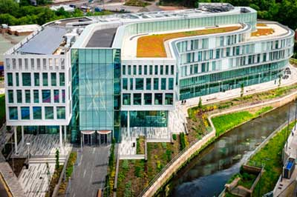
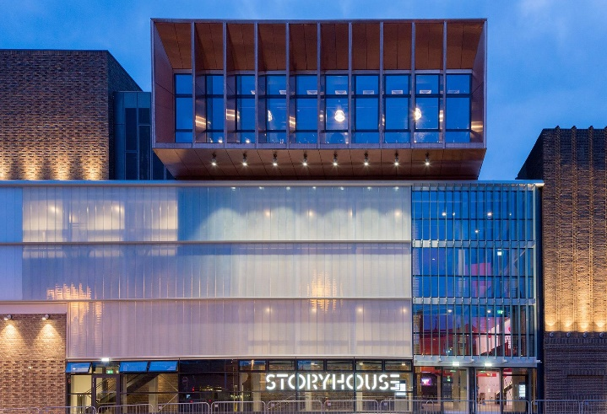
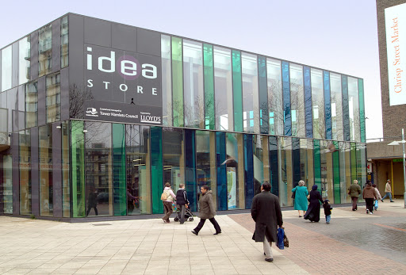
What inspired Stockroom?
There are strong national and international examples of the benefits of library, heritage, cultural, education and other services moving into shared locations which are easy to access. We've looked elsewhere at how this can work.
Storyhouse in Chester has attracted more than one million visitors a year to a multi-use facility in the city centre. It has become a new home to 150 local groups and driven a significant increase in reading among young people.
After creating new mixed-use town centre libraries and cultural hub, visitor figures at Tower Hamlets Idea Stores increased from 550,000 to more than 2 million.
Investment in 21st Century facilities enabled Chester and Tower Hamlets to buck a national trend.
While Chester and Tower Hamlets have brought a huge increase in visitors to town centre locations, nationally, libraries have struggled with the Department for Digital, Culture, Media and Sport identifying a 17% drop in usage between 2005 and 2020.
Stockroom would inspire lifelong learning among children, young people and adults of all ages and help the borough to address the underperformance of educational attainment, particularly at ‘A’ Level and among children in disadvantaged areas or with special educational needs or disabilities.
In addition there are 11,000 adults in Stockport who have real trouble reading. For them, everyday tasks such as booking a doctors appointment, reading road signs or food shopping can be incredibly challenging.

Slide 5
What could Stockroom be?
Stockroom - a ‘learning and discovery space’ which could inspire, entertain and support the people of Stockport and drive people back into the town centre, better supporting shops and businesses.
Stockroom - bigger than a football pitch, filled with great stuff to discover
Stockroom – a truly inclusive space for everyone to use, fully accessible and with features designed in partnership with people with dementia and those on the autistic spectrum
Stockroom - a fantastic, convenient new arrival point for the town centre, could breathe new life into empty retail spaces in the heart of Merseyway.
Stockroom - a place to celebrate the rich culture, creativity and diversity of Stockport, where the past, present and future could come together.
Stockroom - a place to spend time exploring with friends and family, children and grandchildren, parents and grandparents.
Stockroom – with brand new 'best in class' toilet facilities with enhanced facilities for people with a disability.

Slide 6
What could Stockroom offer for the people of Stockport?
Greater prosperity
Breathing life back into empty retail space bringing people back to the High Street
Create more and better jobs and good business growth
Helping everyone achieve their full potential
Increase skills to get more people working
Providing research and study space with opportunities for lifelong learning
Healthier, happier lives
Through learning, discovery, social connections and support when people need it
Stronger, more resilient communities
A place for people of all ages and backgrounds to come together and celebrate our heritage
Improved reading and literacy
Through improved access to a 21st Century library offer
Cultural and creative enrichment
Through improved access to cultural services
Better access to digital services and technology
Through access to top end IT hardware and software packages and support

Slide 7
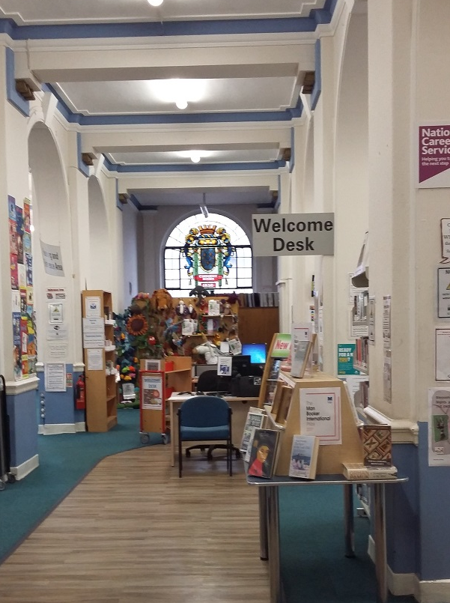
The Central Library building
If there is support to create an enhanced 21st Century library offer within
Stockroom, this could result in library services being relocated from
the existing Central Library Building on the A6.
However a formal consultation on the relocation of library services
from the existing Central Library Building would be held before any
decision was made. This would include consulting people about potential
alternative uses for the current Central Library building.
No decision about the future of the Central Library building or the
service it provides would be made without full consultation with the
people of Stockport, including those people who currently use the
library.
There may also be support for relocating other Council services to
Stockroom and it should also be noted that this may also mean they
might be relocated from their current location

Slide 8
We’ve secured the funding...
We want the best for the people and businesses of Stockport.
Attracting money and investment to Stockport helps us to make the borough a better place to live, work and visit.
Stockport has successfully bid for £14.5m of Government money to create a new learning and discovery store which would help to bring hundreds of thousands of additional people to the heart of the town centre.
An important part of this process now is to ask residents their views on what they want to see inside the Stockroom development which has the potential to include a new 21st Century library, media centre and mixed-use events and leisure space.

Slide 9
Now we need your help to create something special!
We want to talk with you about what uses Stockroom could have and how those uses could benefit yourself individually as well as our children, young people, adults and town centre businesses.
We want Stockroom to be designed around how you would use the space. We’ve split the potential uses of Stockroom into four ‘Zones’ that we think reflect the potential for the space – ‘Discovery’, ‘Family’, ‘Community’, and ‘Learning’.
Have a think about the type of things you might like to see in Stockroom and complete the survey. If you think of something that isn’t listed, please let us know as we need your input to help us shape what Stockroom could be.
Your input can help shape the future of Stockport town centre and the prosperity of people and businesses.
Please complete the survey and let us have your views

Slide 10
Stockroom Engagement
Thanks for your support!
Further information is available at
https://stockroomstockport.uk.engagementhq.com/stockroom
Or email: consultation@stockport.gov.uk
Complete the survey and have your say
https://stockroomstockport.uk.engagementhq.com/stockroom

Slide 11
Future Upcoming Engagement
The Local Plan – A plan for Stockport by Stockport (Summer and Autumn 21)
Active Communities Strategy (Summer 21)
Stockport Interchange Park (July 21)
District and Local Centres Strategy (Summer/Autumn 21)
Housing Strategy??
Romiley to Stockport cycle path consultation (July 21)
Active Neighbourhoods (Autumn 21)
Make sure you Have Your Say at www.stockport.gov.uk/haveyoursay

